Slide 1
Memory Management

Slide 2
TEAM MEMBERS
SM MONISHA 93952_IN
N NANDINI 94005_IN
MAHANTESH KUMBAR 93957_IN
T DIVYA SRI 93950_IN
ARVETI NAVEEN 93939_IN
KL SAIKRISHNA 94036_IN

Slide 3
CONTENT
MANAGE VIRTUAL MEMORY
PAGE TABLE IN LINUX
ALGORITHM USED IN MEMORY MANAGEMENT
SWAPPING
MEMORY MAPPING

Slide 4
MANAGE VIRTUAL MEMORY
What is virtual memory ?
Virtual memory is one of the most important piece of an operating system. Understanding the basics of virtual memory is required to understand operating system performance. Beyond the basics, a deeper understanding allows a system administrator to interpret system profiling tools better, leading to quicker troubleshooting and better decisions.
The concept of virtual memory is generally taught as though it’s only used for extending the amount of physical RAM in a system. Indeed, paging to disk is important, but virtual memory is used by nearly every aspect of an operating system.

Slide 5
PAGE TABLE IN LINUX
A page table is the Data Structure used by a virtual memory system in a computer operating system to store the mapping between virtual addresses and physical addresses. Virtual addresses are used by the program executed by the accessing process, while physical addresses are used by the hardware, or more specifically, by the RAM subsystem.
The page table is where the operating system stores its mappings of virtual addresses to physical addresses, with each mapping also known as a page table entry (PTE)

Slide 6
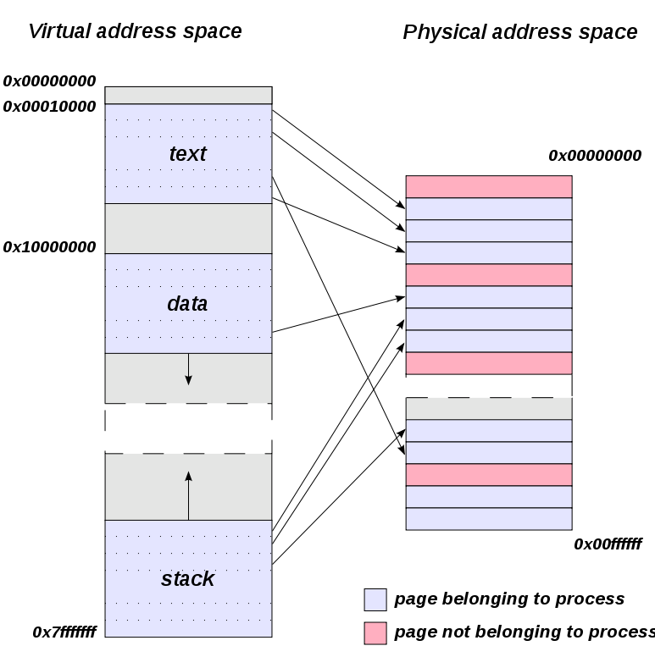

Slide 7
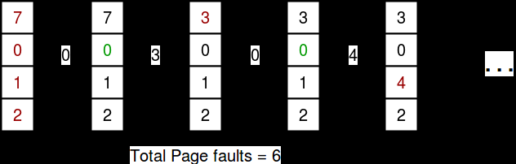
ALGORITHM USED IN MEMORY MANAGEMENT
LRU(Least Recently Used) :
In the Least Recently Used (LRU) page replacement policy, the page that is used least recently will be replaced.
Let
Page reference string:7 0 1 2 0 3 0 4 2 3 0 3 2
Page slots empty:4

Slide 8
BUDDY SYSTEM
In the buddy system the memory will be single contiguous free block
Whenever the request araise by the process memory will be divided into two blocks
If the request from the processor is two small, then the lower block of the memory will be divided into half block again.
If the request is araised by the processor then the memory will be allocated from lower block to higher block

Slide 9
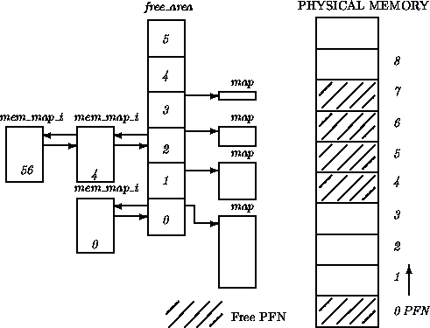
PAGE ALLOCATION
The page allocation code attempts to allocate a block of one or more physical pages.
Pages are allocated in blocks which are powers of 2 in size.
That means that it can allocate a block 1 page, 2 pages, 4 pages and so on.
PAGE DEALLOCATION
Allocating blocks of pages tends to fragment memory with larger blocks of free pages being broken down into smaller ones.
The page deallocation code
recombines pages into larger blocks of free pages whenever it can.

Slide 10
SWAPPING

Slide 11
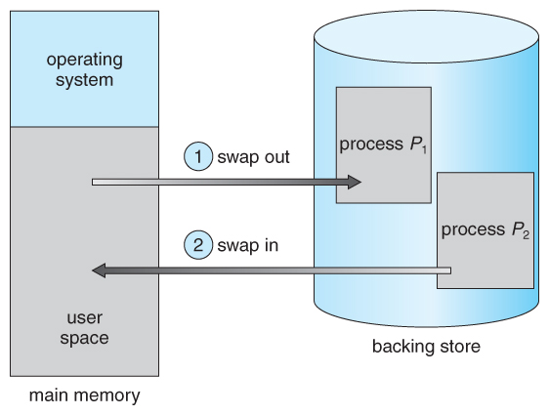
Swapping is the process whereby a page of memory is copied to the preconfigured space on the hard disk, called swap space, to free up that page of memory.

Slide 12
MEMORY MAPPING

Slide 13
Memory Mapping
The interfacing between the microprocessor and the memory device by connecting the data and address bus is called memory mapping.
Memory mapped file:
Memory mapped files provide a mechanism for a process to access files by directly incorporating file data into the process address space.
Mapped memory regions, also called shared memory areas, can serve as a large pool for exchanging data among processes.
The system provides two methods for mapping files.They are
shmat services
mmap services

Slide 14
Shmat services:
Used to create and use shared memory segments from a program.
The shmat subroutine allows processes to share the addresses of the mapped objects.
The shmat services include the following subroutines:
shmctl: Controls shared memory operations
shmget: Gets or creates a shared memory segment
shmat: Attaches a shared memory segment from a process. Does not allow you to map block devices.
shmdt: Detaches a shared memory segment from a process
mprotect: Modifies the access protections of a specified address range within a shared memory segment.
disclaim: Removes a mapping from a specified address range within a shared memory segment.

Slide 15
mmap segment :
Used for mapping files, although it may be used for creating shared memory segments as well.
The mmap subroutine provides a unique object address for each process that maps to an object.
The mmap services include the following subroutines:
madvise : Advises the system of a process' expected paging behavior
mincore: Determines residency of memory pages
mmap: Maps an object file into virtual memory. Allows you to map block devices one process at a time.
mprotect: Modifies the access protections of memory mapping
msync: Synchronizes a mapped file with its underlying storage device
munmap: Unmaps a mapped memory region

Slide 16


